Slide 1
Human Resources Management
Instructor: Erlan Bakiev, Ph.D.

Slide 2
Chapter 2
Managing Work Flows and Conducting Job Analysis
Notes:
With the changing nature of commerce and work flows, organizations are having to rethink jobs and processes to accommodate the global and technological aspects of change affecting today’s workplace. The workforce of today is considerably different from the workforce of the last decade. Let’s take a look at what managers and HR staff must consider when developing and managing work flows and job analyses.

Slide 3
Chapter Challenges
Understand the organizational perspective of work
Understand the group perspective of work
Understand the individual perspective of work
Develop competence in designing jobs and conducting job analysis
Notes:
The powerful forces of technology and global competition are forcing managers to rethink all aspects of business. The result of rethinking business means that companies are changing the basic work processes, job requirements, job expectations, and organizational structures to accommodate today’s workplace.
In Chapter 2, we will look at the various organizational structures to fit the new workplace demands. Specifically, we will look at the overall organizational perspective, the group perspective, and the individual perspective. Additionally, we’ll look at the ways in which jobs are designed and look at how to conduct job analyses.

Slide 4
Chapter Challenges
Have familiarity with the flexible workforce
Maintain human resource information systems
Notes:
Additionally in Chapter 2, we’ll look at the necessity of organizations needing to accommodate a flexible workforce.
Finally, we’ll also learn about the human resource information systems.

Slide 5
Work: The Organizational Perspective
Work Flow
Organizational Structure
The way work is organized to meet the organization’s production or service goals
The formal or informal relationships between people in an organization
Notes:
Work flow is the way work is organized to meet the organization’s production or service goals.
Organizational structure supports work flow and refers to the formal and informal relationships between people in an organization. The organizational structure impacts much of how an organization’s processes, communication, and relationships are managed. Furthermore, organizational structures are designed to best meet the nature of the type of organization and industry in which it competes. For example, Whole Foods will have a more flatter structure with decision making at the horizontal level, whereas the U.S. Army will have more hierarchical structures that meet a more bureaucratic need.
Human resources strategies should support both the work flow of the organization and the organizational structure.

Slide 6
Work: The Organizational Perspective
Strategy
Defender Strategy
Prospector Strategy
Notes:
The business strategy selected by management determines the structure most appropriate to the organization. Whenever management changes its business strategy, it should also reassess its organizational structure. Defender strategy: Chosen when the organization is competing in a stable market and has well-established products. For example, a regulated electric utility company might adopt such a strategy.
Prospector strategy: Chosen when the organization is operating in uncertain business environments that require flexibility. The types of companies operating in this environment are experiencing rapid growth and launching many new products.

Slide 7
Work: The Organizational Perspective
Designing the Organization
Bureaucratic Organization
Flat Organization
Boundaryless Organization
Notes:
There are several ways to structure an organization. The structures we will address in the following slides are bureaucratic, flat, and boundaryless organizational structures.

Slide 8
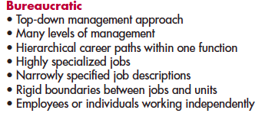
Bureaucratic Organizations
Notes:
Organizations that adopt a defender business strategy are likely to choose the bureaucratic organizational structure. This structure consists of hierarchies with many levels of management. It uses a top-down or “command-and-control” approach to management in which managers provide considerable direction to and have considerable control over their subordinates.

Slide 9
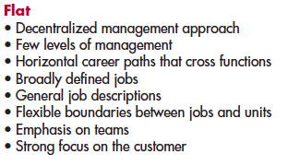
Flat Organizations
Notes:
An organization that selects the prospector business strategy is likely to choose the flat organizational structure.
A flat organization has only a few levels of managers and emphasizes a decentralized approach to management. Flat organizations encourage high employee involvement in business decisions.

Slide 10
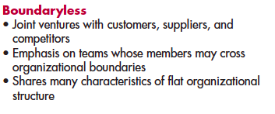
Boundaryless Organizations
Notes:
A boundaryless organizational structure enables an organization to form relationships with customers, suppliers, and/or competitors, either to pool organizational resources for mutual benefit or to encourage cooperation in an uncertain environment.

Slide 11
Work-Flow Analysis Examines how:
Work creates or adds value to the ongoing process in a business
Work moves from the customer through the organization and then as a product or service
Some steps or jobs can be eliminated, combined, or simplified
Alignment between employees’ work and customer needs is arranged
Notes:
Work-flow analysis:
1. Examines how work creates or adds value to the ongoing process in a business
2. Examines how work moves from the customer through the organization and then as a product or service
3. Examines how some steps or jobs can be eliminated, combined, or simplified
4. Tightens the alignment between employees’ work and customer needs
When it is determined that the whole process needs to be rethought, a company will engage in business process reengineering (BPR).

Slide 12
Business Process Reengineering (BPR)
Notes:
The term reengineering was coined by Michael Hammer and James Champy in their pioneering book Reengineering the Corporation.
Business process reengineering (BPR): This is not a quick fix but rather a fundamental rethinking and radical redesign of business processes to achieve dramatic improvements in cost, quality, service, and speed.
Figure 2.2 shows the steps in processing a loan application at IBM Credit Corporation both before and after BPR.

Slide 13
Work: The Group Perspective
Teams
Small number of people
Five or six considered optimal number
Complementary skills
Vital in flat organizations
Boundaryless organizations
Notes:
Teams: A small number of people with complementary skills who work toward common goals for which they hold themselves mutually accountable. The optimal number for teams is five or six members. Teams are generally found in boundaryless organizations that have flat organizational structures.
Several types of teams are used in organizations today.

Slide 14
Work: The Group Perspective
Types of Teams
Self-Managed Team
Members usually cross-trained
Problem-Solving Teams
Volunteer members; temporary
Special-Purpose Teams (task force)
Complex issues
Virtual Teams
Geographically dispersed
Notes:
There are a number of different types of teams, including self-managed, problem-solving, special-purpose, and virtual teams. Self-managed teams: Teams responsible for producing an entire product, a component, or an ongoing service.
Problem-solving teams: Teams consisting of volunteers from a unit or department who meet for one or two hours per week to discuss quality improvement, cost reduction, or improvement in the work environment.
Special-purpose teams: Teams or task forces consisting of workers who span functional or organizational boundaries and whose purpose is to examine complex issues.
Virtual teams: Teams that rely on interactive technology to work together when separated by physical distance.

Slide 15
Work: The Individual Perspective
Motivation
Two-Factor Theory
Work Adjustment Theory
Goal-Setting Theory
Job Characteristics Theory
Notes:
Motivation can be defined as that which energizes, directs, and sustains human behavior. Motivation theory seeks to explain why employees are more motivated by and satisfied with one type of work than another.
Two-factor theory by Hertzberg attempts to identify and explain the factors that employees find satisfying and dissatisfying about their jobs. One factor is hygiene or maintenance factors that must be present for there to be no dissatisfaction. The other factors are motivators that are internal job factors that lead to job satisfaction and higher motivation.
Work adjustment theory considers the fit between employee needs and abilities and the overall job. The idea is that the better the fit, the more motivated a worker will be.
Goal-setting theory looks at setting goals that are clear, challenging, and attainable. The more a manager can provide goals with these characteristics and consistent feedback, the higher the motivation level of the individual will be.
Job characteristics theory, by Hackman and Oldham, states that employees will be more motivated to work and more satisfied with their jobs to the extent that jobs contain certain core characteristics. We’ll take a closer look at the job characteristics model (theory).

Slide 16
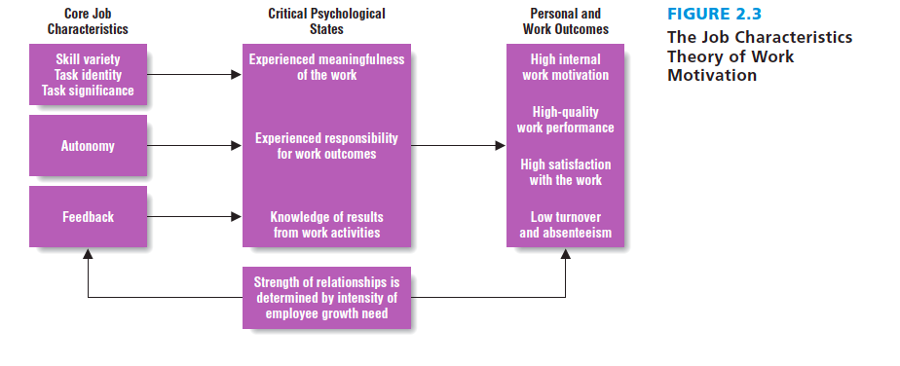
Job Characteristics Theory
Notes:
There are five core job characteristics that activate three critical psychological states. The core job characteristics are:
Skill variety—involves different tasks and requires a variety of different skills, abilities, and talents
Task identity—the degree to which a person can do the job from beginning to end with visible outcome
Task significance—the degree to which the job impacts others and is perceived as important
Autonomy—the amount of freedom to make decisions and the ability of the employee to use discretion
Feedback—the degree to which the job provides the employee with clear and direct information
Jobs must be designed to include these five core job characteristics that will lead to positive psychological states (experienced meaningfulness, responsibility, and knowledge of results) and organizationally desired personal and work outcomes (higher motivation, work performance, and satisfaction).

Slide 17
Job Design
The process of organizing work into the tasks required to perform a specific job
Notes:
Job design is the process of organizing work into the tasks required to perform a specific job.
Now let’s look at the five approaches to job design. The three important influences on job design are (1) work-flow analysis, (2) business strategy, and (3) organizational structure that best fits that strategy.

Slide 18
Five Approaches to Job Design
Work Simplification
Job Enlargement
Job Rotation
Job Enrichment
Team-Based Design
Notes:
Work simplification: Assumes that work can be broken down into simple, repetitive tasks that maximize efficiency.
Job enlargement: Expands the job’s duties by adding extra duties and is created to mitigate job boredom. Job rotation: Rotates workers among different narrowly defined tasks without disrupting the flow of work. Job rotation is also created to reduce job boredom.
Job enrichment: Gives employees more opportunities for autonomy and feedback. It expands both the horizontal and vertical dimensions of a job.
Team-based design: Focuses on giving a team, rather than an individual, a whole and meaningful piece of work to do.

Slide 19
Job Analysis
The systematic process of collecting information used to make decisions about jobs. Job analysis identifies the task, duties, and responsibilities of a job.
Notes:
Job analysis: The systematic process of collecting information used to make decisions about jobs. Job analysis identifies the tasks, duties and responsibilities of a particular job. Task: A basic element of work that is a logical and necessary step in performing a job duty.
Duty: Consists of one or more tasks that constitute a significant activity performed in a job.
Responsibility: One or several duties that identify and describe the major purpose or reason for the job’s existence.

Slide 20
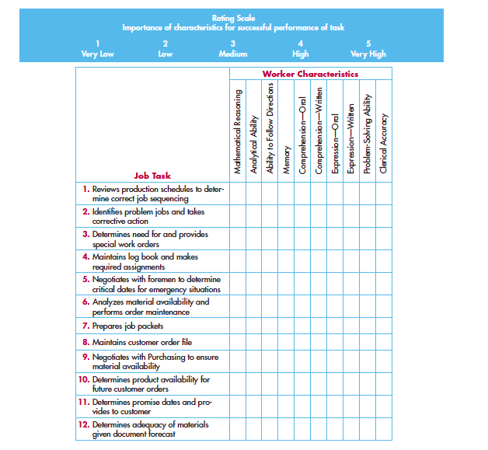
Sample Task by KSA Matrix
Notes:
A task inventory analysis is actually a collection of methods that are offshoots of the U.S. Air Force task inventory method. The technique is used to determine the knowledge, skills, and abilities (KSAs) needed to perform a job successfully. The analysis has three steps: (1) an interview, (2) a survey, and (3) generation of a task by a KSA matrix.
This KSA matrix is used to rate the extent to which a variety of KSAs are important for the successful completion of each task. This figure is an abbreviated example of a KSA rating matrix.

Slide 21
Guidelines for Conducting a Job Analysis
Determine the desired applications of the job analysis
Select the jobs to be analyzed
Gather the job Information
Verify the accuracy of the job information
Document the job analysis by writing a job description
Notes:
Guidelines for conduction a job analysis:
1. Determine the desired applications of the job analysis: should collect information on necessary knowledge, skills, and abilities that lead to job performance.
2. Select the jobs to be analyzed: jobs analyzed can include stability or obsolescence of job content and entry-level jobs.
3. Gather the job information: collect the desired information given the budget constraints.
4. Verify the accuracy of the job information: both job incumbents and their supervisors should review the job information.
5. Document the job analysis by writing a job description: summarize the essential duties and responsibilities as well as knowledge, skills, and abilities necessary for the job.

Slide 22
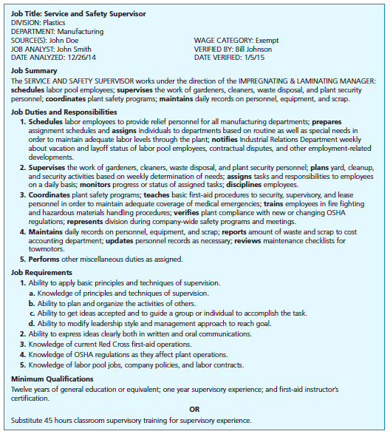
Job Description
Notes:
A job description is the summary of the job analysis. Elements of the job description include (1) identification of information, (2) job summary, (3) job duties, (4) job responsibilities, (5) job specifications (KSAs), and (6) minimum qualifications.
Identification information includes job titles, location, and source of job-analysis information (e.g., DOL information in the Occupational Outlook Handbook of the Bureau of Labor Statistics).
The job summary is a short statement that summarizes the job’s duties, responsibilities, and place in the organizational structure.
Job duties explain what is done on the job, how it is done, and why it is done.
Job specifications lists the KSAs.
Minimum qualifications are the basic standards a job applicant must have to be considered for the job.

Slide 23
Emerging Trends: Flexible Schedules
Contingent Workers
Temporary employees
Part-time employees
Outsourcing/subcontracting
Contract workers
College Interns
Notes:
Contingent workers are hired to deal with temporary increases in an organization’s workload or to do work that is not a part of its core set of capabilities. Contingent workers include temporary employees (those hired for short-term work assignments through a third-party temporary agency), part-time employees (those who work less than 35 hours per week), and outsourcing/subcontracting employees (agreements/contracts with those employees who work for a third- party company, but are hired for specific work). Contract workers are employees who develop work relationships directly with the employer for specific work. College interns are the newest development in contingency work and consist of college students who work either full- or part-time or are hired without pay.

Slide 24
HRIS Applications
Notes:
Human resource information systems (HRISs) are systems used to collect, record, store, analyze, and retrieve data concerning an organization’s human resources. A computerized HRIS contains computer hardware and software applications that work together to help managers make HR decisions. The table includes many HRIS applications.

Slide 25
Summary and Conclusions
Work: The Organizational Perspective
Business strategy determines structure
Work: The Group Perspective
Various team structures
Work: The Individual Perspective
Motivation
Designing Jobs and Conducting Job Analysis
Process of designing and organizing work into specific jobs
The Flexible Workforce
Present in dynamic markets
Human Resource Information Systems
Notes:
To summarize, The organizational perspective concerns a firm’s business strategy in how it determines how it structures its work. Organizations may have beaurocratic, flat, or boundaryless structures.
The group perspective concerns various team structures that may exist in firms. There may be self-managed, problem-solving, special-purpose, or virtual teams.
The individual perspective concerns various motivation theories: two-factor, work adjustment, goal-setting, and job characteristics theories. All are important in understanding how to manage individuals.
Designing jobs and conducting job analysis: Job design is the process of organizing work into the tasks required to perform a specific job. Job analysis is the systematic process of gathering and organizing information concerning the tasks, duties, and responsibilities of jobs.
Flexible workforce: Helps managers in dynamic markets in dealing with unexpected jolts in the environment and accommodating the needs of a diverse workforce.
HRISs: Used to collect, record, store, analyze, and retrieve relevant HR data.

Slide 26
Pearson Education, Inc. Copyright

