Slide 1
Human Resources Management
Instructor: Erlan Bakiev, Ph.D.

Slide 2
Chapter 7
Appraising and Managing Performance
Notes:
In order to measure performance, organizations must develop ways in which to design and implement effective performance appraisals that improve performance. This appraisal process includes providing feedback to employees regarding performance, and, in some organizations, employees receive feedback from many constituents (peers, customers, vendors, and self). Chapter 7 will provide an overview of performance appraisals within organizations.

Slide 3
Chapter Challenges
How to effectively carry out each of the steps in performance appraisal
Have familiarity with challenges to effective performance measurement
Develop competence in managing performance
Notes:
In Chapter 7, we’ll look at how to effectively carry out each of the steps in performance appraisal, gain familiarity with challenges to effective performance measurement, and develop competence in managing performance.

Slide 4
What Is Performance Appraisal?
Notes:
Performance appraisal includes the identification, measurement, and management of human performance in organizations. Identification means determining what areas of work the manager should be examining when measuring performance. Rationally and legally defensible identification requires a measurement system based on job analysis. Measurement (the centerpiece of the appraisal system) entails making managerial judgment of how good or bad employee performance was. Measurement must be consistent throughout the organization in order to avoid legal ramifications. Management is the overriding goal of any appraisal system. Appraisals should be more than a past-oriented activity that criticizes or praises worker performance. Rather, it should take a future-oriented view of what workers can do to achieve their potential. This will mean managers must provide immediate and frequent feedback.

Slide 5
Uses of Performance Appraisals
Administrative Purposes
Developmental Purposes
Notes:
Organizations usually conduct appraisals for administrative and/or developmental purposes. Performance appraisals are used administratively whenever they are the basis for a decision about the employee’s work conditions, including promotions, termination, and rewards. Developmental uses of appraisal, which are geared toward improving employees’ performance and strengthening their job skills, include providing feedback, counseling employees on effective work behaviors, and offering them training and other learning opportunities.

Slide 6
Identifying Performance Dimensions
Dimension
Quality of work
Quantity of work
Interpersonal effectiveness
Competencies
Notes:
The first step in the performance appraisal process is identifying what is to be measured. Dimension refers to an aspect of performance that determines effective job performance. One of the first suggestions in generating dimensions of performance is to decide the quality of work that should be done. The second dimension is the quantity of work performance, and the third is the interpersonal effectiveness dimension. When determining the dimensions, it is important to remember that what is measured should be directly tied to what the business is trying to achieve.
Another approach to identifying performance dimensions focuses on competencies, which are characteristics associated with successful performance. These characteristics should be observable.

Slide 7
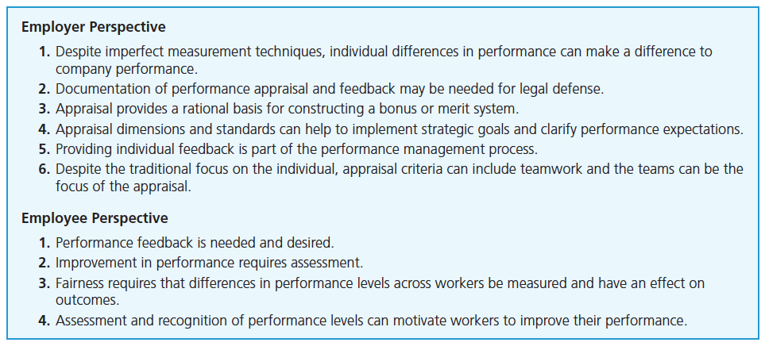
Benefits of Performance Appraisal
Notes:
There are several benefits of a performance appraisal. The employer benefits include improving performance that impacts the company, providing a sound legal defense if implemented correctly, and helping reach strategic goals and clarify performance expectations. From the employee perspective, the benefits are that the performance appraisal feedback informs the employee of performance and can motivate employees toward improving their performance.

Slide 8
Measuring Performance: Type of Judgment
Relative Judgment
Rank order
No absolute information
Absolute Judgment
Based on performance standards
Lessens conflict among workers
Notes:
Appraisal systems based on relative judgment ask supervisors to compare an employee’s performance to the performance of others. A rank order is typical of this type of appraisal system. Relative rating systems have an advantage of forcing supervisors to differentiate among their workers; however, one disadvantage is that it’s not clear how great or small the differences between the employees are.
On the other hand, absolute judgment systems ask supervisors to make judgments about their employees’ performance based solely on performance standards. However, one drawback to absolute systems is that workers can receive the same rating if the supervisor makes no differentiation among the employees. The one advantage of absolute systems is that they help avoid conflict among employees because employees are ranked on their own merit instead of against each other.

Slide 9
Measuring Performance
Trait Appraisal
Worker characteristics
Behavioral Appraisal
Worker behavior
BARS
Outcome Data
Results
MBO
Notes:
In addition to relative and absolute judgments, performance measurement systems can be classified by the type of performance data on which they focus: trait data, behavioral data, or outcome data.
Trait appraisal instruments are an appraisal tool that asks a supervisor to make judgments about worker characteristics (decisiveness, reliability, energy, and loyalty) that tend to be consistent and enduring. Trait appraisals are subject to perceptual biases. The next slide shows an example of a trait appraisal instrument.
Behavioral appraisal instruments are appraisal tools that asks managers to assess a worker’s behaviors. Behaviors are ranked across a behavioral scale in BARS, which is more legally defensible. Behavioral scales provide employees with specific examples of the types of behavior to engage in if they want to do well in the organization. The textbook chapter provides a great snapshot example of a BARS instrument.
Outcome appraisal instruments are tools that ask managers to assess the results achieved by workers. The most prevalent outcome approach is MBO—management by objectives. This tool tends to eliminate subjectivity and instead provides clear criteria on which to be measured. One downfall of this approach is the mentality of “results at any cost.” Ethics can then be a concern with this method.

Slide 10
Sample Trait Scale
Notes:
This is a sample trait appraisal instrument, which shows that traits can be ranked on a Likert Scale. These four traits are ones typically found on these types of instruments. One drawback to using this trait scale is that it is less defensible in court than other types of ratings. Definitions of reliability can differ dramatically across supervisors. These types of instruments also tend to focus on the person, rather than the performance.

Slide 11
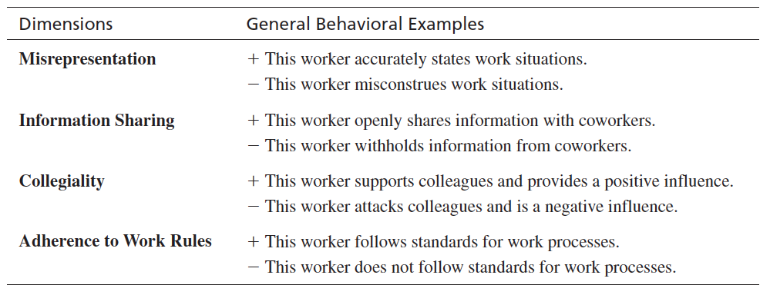
Assessing Ethical Behavior
Notes:
Performance appraisal is typically focused on tasks and business accomplishments. Ethical conduct is often identified as a guiding value at the organizational level, but how does that translate into everyday performance on the job? The behavioral examples shown are general and provide only a broad behavioral description of each dimension. The behavioral descriptions would probably be most useful if they were customized for each organizational setting.

Slide 12
Measurement
Self-rating
Peer review
Subordinate review
Customer review
360° feedback
Notes:
Other rater sources (other than supervisor) can provide unique and valuable perspectives to the performance appraisal process. Self-review is a performance appraisal system in which workers rate themselves. It provides a sense of accountability and the perspective of employee regarding his or her job position and responsibilities.
Peer review is a performance system in which workers at the same level in the organization rate one another.
Subordinate review is a performance appraisal system in which workers rate their supervisors.
360-degree feedback can offer a well-rounded picture of the employee’s performance from multiple perspectives (virtually everyone who has any connection to the employee, from peer to supervisor, customer, and self).

Slide 13
Challenges to Effective Performance Measurement
Rater errors and bias
The influence of liking
Organizational politics
Individual or group focus
Legal issues
Notes:
How can managers ensure accurate measurement of worker performance? The primary means is to understand the barriers that stand in the way. Managers have at least five challenges:
Rater errors and biases: No matter how much one tries to be objective, there are biases that can exist. A rater error is an error in the performance appraisal that reflects consistent biases on the part of the rater. Personal biases may also cause errors in evaluation. In the next slide, we’ll look closer at the various rater errors and biases.
The influence of liking: Liking can cause errors in performance appraisals when raters allow their like and dislike of an individual to influence their assessment of that person’s performance.
Organizational politics: Assumes that the value of a worker’s performance depends on the agenda or goals of the supervisor. Some say the appraisals in most organizations seem to be more political rather than a rational exercise.
Individual or group focus: If the organization has a team structure, managers will conduct team performance appraisals at two levels: (1) individual contribution to team performance and (2) team unit performance. Individual contribution measures are best developed with the input of the team members. Competencies are decided and evaluated at the individual level. Dimensions for measuring team performance may be set at higher levels in the organization.
Legal issues: The major legal requirements for performance appraisal systems are set forth in Title VII of the Civil Rights Act of 1964, meaning that the performance appraisal must be free of discrimination at both individual and group level. Validity standards should be met and instruments/systems must not result in adverse impact. The following are found to be favorable influences in court: (1) use of job analysis, (2) providing written instructions, (3) allowing employees to review appraisal results, (4) agreement among multiple raters, and (5) the presence of rater training.

Slide 14
Rater Errors
Halo Error
Restriction of Range Error
Leniency Error
Central Tendency Error
Severity Error
Notes:
The following are rater error and biases:
Halo error: The tendency to rate similarly across dimensions. There are at least two causes of halo error: (1) a supervisor makes an overall judgment about a worker and then conforms all dimensional ratings to that judgment and/or (2) a supervisor may make all ratings consistent with the worker’s performance level on a dimension that is important to the supervisor.
Restriction of range error: Occurs when a manager restricts all of his or her ratings to a small portion of the rating scale. Three different forms of range restriction are common: (1) leniency errors (restricting ratings to the high portion of the scale), (2) central tendency errors (ratings in the middle of the scale), and (3) severity errors (ratings at the low end of the scale).

Slide 15
Performance Measurement Difficulties
Comparability
Frame-of-Reference
Notes:
Comparability refers to the degree to which the performance ratings given by various supervisors in an organization are based on similar standards. Supervisors should use the same measurement yardsticks.
One of the most effective ways to deal with errors and bias is to develop and communicate evaluation standards via frame-of-reference (FOR) training, which uses prepared behavioral examples of performance that workers might exhibit. After rating the performance presented on video or paper, the trainees in a typical FOR session are told what their ratings should have been. FOR has been consistently found to increase the accuracy of performance ratings.

Slide 16
The Appraisal Interview
Performance Discussion
Salary Discussion
Performance Improvement
Notes:
Upon completing the performance rating, the supervisor usually conducts an interview with the worker to provide feedback. Many managers dread the interview, especially if it is a poor performance appraisal. Performance reviews are sometimes separated into two sessions: (1) performance review discussion and (2) salary discussion. The logic behind this system is based on two assumptions: (1) that managers cannot simultaneously be both coach and judge, and (2) that if the performance and salary discussion were combined, employees probably would not listen to their performance feedback because their interest would be focused on salary decisions.
Because formal appraisal interviews typically are conducted once a year, they may not have substantial and lasting impact on worker performance. Supervisors who manage performance effectively share three characteristics: (1) explore causes of performance problems, (2) develop action plans to empower workers to reach a solution, and (3) direct communication at performance and provide effective feedback.

Slide 17
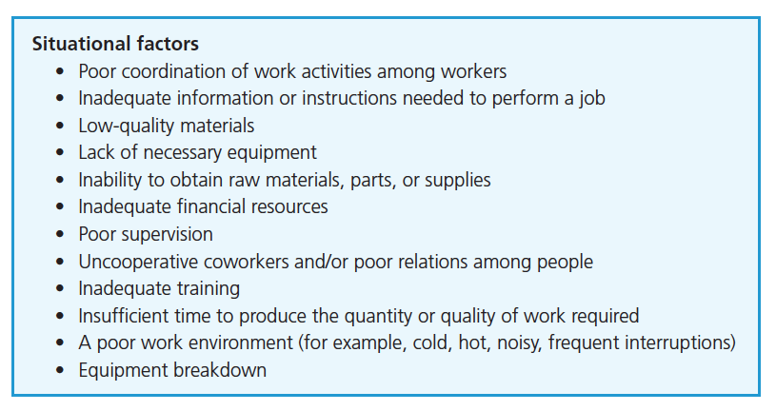
Situational Factors of Performance Issues
Notes:
Here is a brief list of some situational factors to consider that may be the cause of performance problems. This is a starting point. The supervisor and worker or team members can go over a list together to isolate the causes of any performance difficulties. This action makes sense in that it is addressing an underlying problem or problems that need resolving to allow the employee to perform well in the future.

Slide 18
How to Determine and Remedy Shortfalls
Notes:
After the supervisor and worker have discussed and agreed on the causes of performance problems, the next step is to take action to control them. Depending on whether the cause of performance problems is related to ability, effort, or situational characteristics, very different tactics are called for. Here are some examples to review.

Slide 19
Effective Performance Appraisal
Developing an Action Plan and Empowering Workers
Directing Communication at Performance
Notes:
Effective performance management requires empowering workers to improve their performance. The role of the supervisor is more like a coach and enabler. The supervisor should be there to work with the employee and offer guidance and help employee find solutions for resolving any performance issues. Additionally, whatever resources are needed to help this process (e.g., training) should be utilized.
Directing communication at performances (between supervisor and worker) is critical to effective performance management. Positive and constructive feedback will be key. Maintaining composure and keeping it professional in tone and behavior are also key.

Slide 20
Summary and Conclusions
What Is Performance Appraisal?
Identifying Performance Dimensions
Measuring Performance
Managing Performance
Notes:
Performance appraisals are critical to the ongoing success of an organization. Understanding the performance appraisal and process will help managers and employees work toward a more successful communication and trust, which will lead to positive performance outcomes. Measuring performance accurately is not only good practice, but also avoids legal pitfalls and decreases in morale. Managing the performance of the organization takes all constituents working together.

Slide 21
Pearson Education, Inc. Copyright

