Slide 1
Organizational Behavior
BUS-542
Instructor: Erlan Bakiev, Ph.D.

Slide 2
Essentials of
Organizational Behavior, 11/e
Stephen P. Robbins & Timothy A. Judge
Chapter 14
Foundations of Organizational Structure

Slide 3
After studying this chapter, you should be able to:
Identify the six elements of an organization’s structure.
Describe the common organizational designs.
Compare and contrast the virtual and boundary-less organizations.
Demonstrate how organizational structures differ.
Analyze the behavioral implications of different organizational designs.
Show how globalization affects organizational structure.

Slide 4
What is Organization Structure?
It defines how job tasks are formally divided, grouped, and coordinated
Key elements to be addressed:
  Work specialization
  Departmentalization
  Chain of command
  Span of control
  Centralization
  Decentralization
  Formalization
Notes:
Organizational structure depicts how job tasks are formally divided, grouped and coordinated. The key elements of organizational structure include work specialization, departmentalization, chain of command, span of control, centralization, decentralization and formalization.

Slide 5
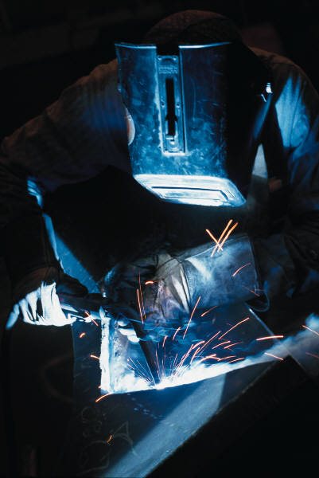
Element 1: Work Specialization
Also known as division of labor
Describes the degree to which activities in the organization are subdivided into separate jobs
Benefits:
  Greater efficiency and lower costs
Costs:
  Human costs when carried too far
  Job enlargement as a solution
Notes:
A key part of organizational structure is understanding the degree to which tasks are divided into separate jobs or work specialization. The division of labor is helpful in creating the most efficient way to utilize employee skills, increase their skills and maximize their input.
Work specialization can cause greater economies, but in some cases it can cause diminishing returns due to repetition which can lead to boredom. Job enlargement can be effective in creating greater efficiencies than specialization.

Slide 6

Element 2: Departmentalization
Basis by which jobs are grouped together so that common tasks can be coordinated
Common bases:
  Function
  Product
  Geography
  Process
  Customer
Notes:
Departmentalization defines how jobs are grouped together. There are a number of options to choose from when grouping jobs; you could organize around function, product, location, process or customer. When jobs are grouped, departments are formed.

Slide 7



Element 3: Chain of Command
Unbroken line of authority that extends from the top of the organization to the lowest echelon and clarifies who reports to whom
Authority: positional rights
Unity of Command principle: one boss
Fewer organizations find this is relevant
Notes:
The chain of command represents the line of authority present in decision making. Embedded in the chain of command is the inherent right of a manager to give orders and expect the orders to be followed. Unity of command is the idea that a subordinate should have only one superior to report to so that directions and the chain of command are clear.
As organizations change this concept is becoming less and less important.

Slide 8
Element 4: Span of Control
The number of employees a manager is expected to effectively and efficiently direct
Determines the number of levels and managers an organization has
  Trend is toward wider spans of control
  Wider span depends on knowledgeable employees
  Affects speed of communication and decision making
Notes:
The fourth element of structure is span of control. This concept looks at how many workers a manager can effectively direct towards organizational goals. Wider span allows for more efficiency because you need fewer managers. However, it can also limit the amount of time and direction a manager can give to their employees. A narrow span can allow for more direction but can add layers of management, increase the complexity of the vertical communication and encourage overly tight supervision, limiting employee autonomy.

Slide 9
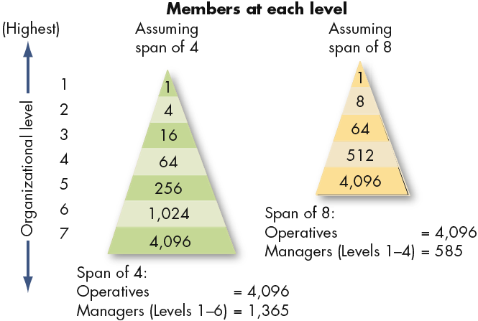
Contrasting Spans of Control
Notes:
The graph on this slide depicts different spans of control.

Slide 10
Element 5: Centralization and Decentralization
Centralization - degree to which decision making is concentrated at a single point in the organization
  Only includes formal authority: positional rights
  Highly centralized when top managers make all the decisions
  Decentralized when front line employees and supervisors make decisions
  Trend is toward increased decentralization
Notes:
The fifth aspect of structure deals with centralization and decentralization. Centralization is the degree to which decision making is concentrated at a single point in the organization, typically at the top. Decentralization represents an organization that spreads decision making throughout the organization.

Slide 11
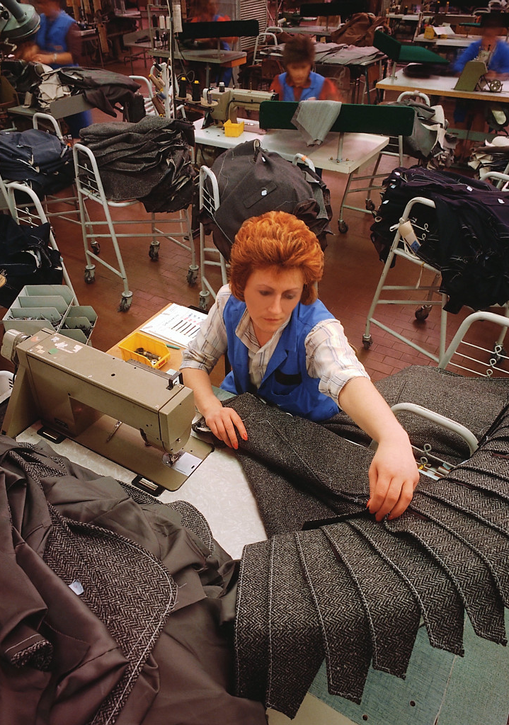
Element 6: Formalization
Degree to which jobs within the organization are standardized
  Formal = minimum discretion over what is to be done, when it is done, and how
  Informal = freedom to act is necessary
Notes:
Formalization is the degree to which jobs within the organization are standardized. When there is high formalization workers have very little control over how they do their work and they will be required to follow a number of rules and procedures. Lower formalization will tend to allow for different job behaviors to get the job done, giving workers more control over their work.

Slide 12
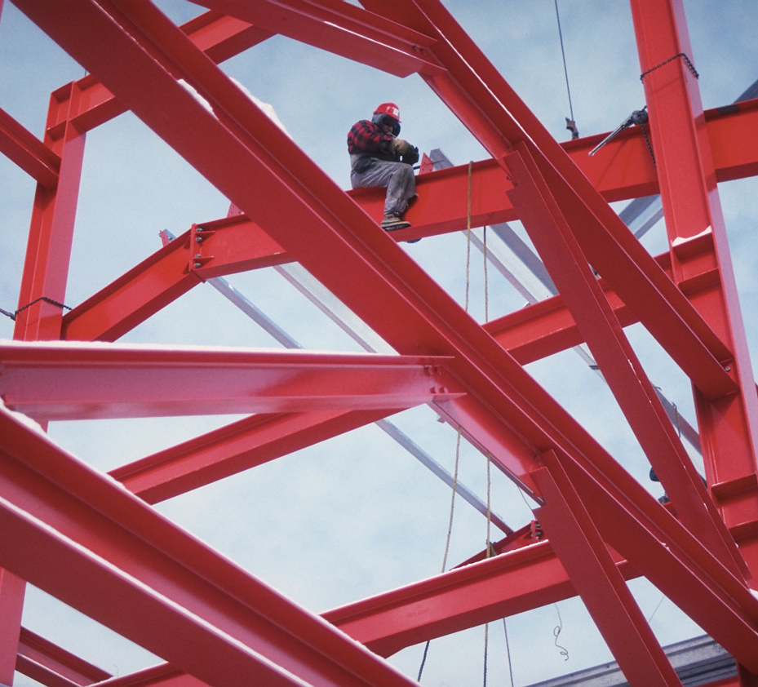
Common Organizational Designs
Simple structure
Bureaucracy
Matrix structure
Notes:
There are a number of organizational structures available to companies. We will look at a number of options over the next several slides.

Slide 13
Simple Structure
Low degree of departmentalization
Wide spans of control
Authority centralized in a single person
Little formalization
Difficult to maintain in anything other than small organizations
Notes:
The first and most basic structure is the simple structure. This structure has a low degree of departmentalization, wide spans of control and centralized decision making with little formalization in job design.
This structure is difficult to utilize in anything other than small organizations.

Slide 14
Bureaucracy
Highly routine operating tasks achieved through specialization
  Formal rules and regulations
  Centralized authority
  Narrow spans of control
  Tasks grouped by functional departments
  Decision making follows the chain of command
Notes:
Another type of organizational design is bureaucracy. In a bureaucratic organization there will be a great deal of structure. The tasks will be completed through specialization, and they tend to be formalized through rules and regulations. Departments will be highly defined by function and authority is centralized. Decision making will follow a strict chain of command and there will be narrow spans of control. The bureaucratic organization will be one that is highly defined and very controlled.

Slide 15
Matrix Structure
Combines two forms of departmentalization
  Functional
  Product
Dual chain of command
Advantages:
  Facilitates coordination and efficient allocation of specialists
Disadvantages:
  Possible confusion, fosters power struggles, stress
Notes:
The matrix structure is another common organizational design. This structure creates dual lines of authority and combines functional and product departments in a way to effectively meet organizational goals.
The key elements of the matrix structure is that it gains the interactions between the functional and product departments by coordinating complex and interdependent activities to help reach the goals set forth in an efficient manner opening up avenues for new ideas to achieve the company’s mission. The matrix structure also breaks down the unity-of-command concept as the lines of authority are blurred.

Slide 16



Matrix Structure for a College of Business Administration
Notes:
This slide shows an example of a matrix structure within a college.

Slide 17
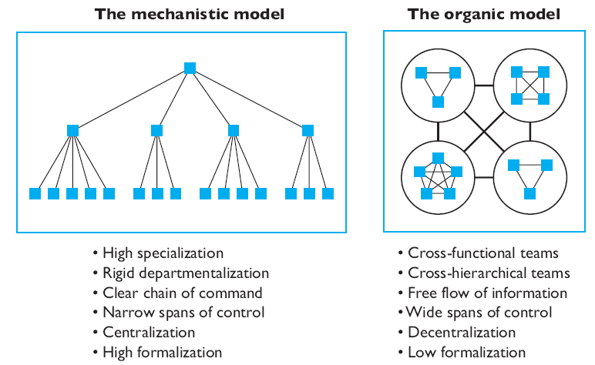
Models of Organizational Design
Notes:
The mechanistic model is contrasted with the organic model in this graph. These are two extreme structures organizations can choose from. The mechanistic model is set up to facilitate high specialization, a clear chain of command and a large degree of formalization. The organic model, in contrast, is set up to facilitate teams, the free flow of information, decentralized, empowerment and very little formalization. It is not that one structure is better than the other, rather each organization needs to see what will work best with their workforce and product.

Slide 18
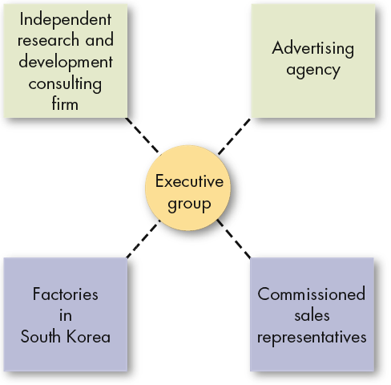
New Design Options - Virtual
  A small, core organization that outsources its major business functions
  Highly centralized with little or no departmentalization
  Provides maximum flexibility while concentrating on what the organization does best
  Reduced control over key parts of the business
Notes:
Virtual organizations are developing as acceptable organizational structures. This structure offers a small core organization that outsources many of its major functions to competent suppliers. Virtual organizations are highly centralized with virtually no departmentalization to provide maximum flexibility, focusing on what the organization does best. This type of organization reduces control over some of the key parts of the business.

Slide 19

The Boundryless Organization
  An organization that seeks to eliminate the chain of command, have limitless spans of control, and replace departments with empowered teams
  T-form Concepts
  Eliminate vertical (hierarchical) and horizontal (departmental) internal boundaries
  Breakdown external barriers to customers and suppliers
Notes:
Boundaryless organizations are set up to reduce the structure and tight control over work. They organize in a way to try to empower teams. They organize more in what is called T-form concepts in order to eliminate vertical and horizontal boundaries. They try to breakdown external barriers to customers and suppliers through their structure and style of communication.

Slide 20
The Leaner Organization: Downsizing
Downsizing: A systematic effort to make an organization leaner by selling off business units, closing locations or reducing staff.
Controversial because of the negative impact on employees
Impact on organizational performance has been very controversial
Notes:
In the midst of tough economic times and the need for companies to be leaner downsizing has been on the rise.
Downsizing is a systematic effort to make an organization leaner by ridding itself of a business units, excessive locations and staff. It has been very controversial because of the strong negative impact on employees. Because of this negative impact the link to performance enhancement has been questioned.

Slide 21
The Four Forces that Influence Structure
Strategy
  Innovation – introduce new offerings - organic
  Cost-Minimization – cost control - mechanistic
  Imitation – minimal risk and maximum profit - both
Organization Size
  Bigger becomes mechanistic
Technology
  Routine equals mechanistic, nonroutine is organic
Environment
  Dynamic environments lead to organic structures
Notes:
Structures differ for a number of reasons. The first is that structure is set up to facilitate the strategy of the organization. If you organization is focusing on innovation as a key value than they may be best served by an organic structure. Whereas, if they are looking at minimizing costs as their strategy they will find that a mechanistic structure will work better. Strategy should always dictate structure instead of structure dictating strategy.
Structures will also differ by organization size, the larger they get they tend to become more mechanistic. They will differ by how much technology is used, the more routine the activities the more mechanistic the structure should be. Structures will also differ based on the environment in which they exist. The more dynamic the environment the more organic the structure will need to be to facilitate quick decisions and fast turnaround.

Slide 22

Organizational Designs and Employee Behavior
Cannot generalize any link between structure and performance
Too much individual variance
Consider employee preferences for:
  Work Specialization
  Span of Control
  Centralization
Notes:
Organizational designs are not a good predictor of employee behavior. Research has shown that work specialization can lead to increased productivity but lower job satisfaction. Specialization has not been popular as employees are seeking more intrinsically rewarding jobs. Span of control has mixed results depending on individual differences in employees and organizational factors. Centralization can facilitate different employee responses.
Various factors will influence workers in their job satisfaction and their willingness to stay with an organization.

Slide 23

Global Implications
Culture and Organizational Structure:
Insufficient research at this point
Culture and Employee Structure Preferences:
National culture does influence
High power distance cultures accept mechanistic structure
Culture and the Boundaryless Organization:
Natural avenue for modern global companies
Notes:
Most countries follow the US model for organizational structure. However, this may be changing as the US model can be too individualistic. Structural effectiveness will vary in countries based on their cultural preferences. However, the research is not conclusive on this issue.
The Boundaryless organization will most likely grow as the economy continues to globalize. This structure tends to break down barriers and increase effectiveness across international boundries.

Slide 24
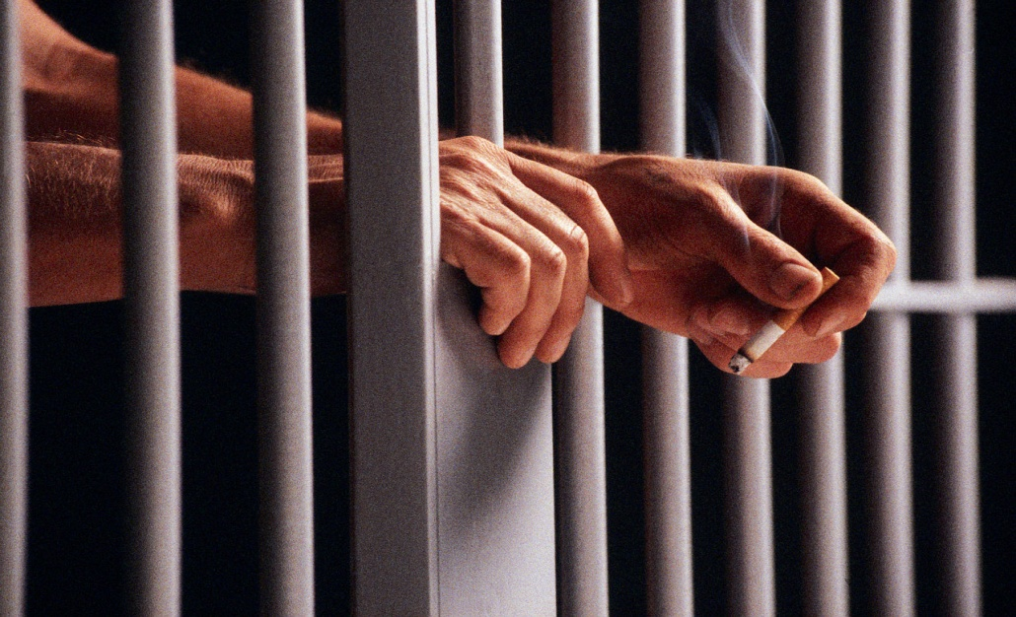
Implications for Managers
Structural relationships impact attitude and behavior
Structure constrains employee behaviors
Notes:
Structure does have an impact on both the attitudes and behaviors of the people within the organization so it is important that managers effectively select and utilize structure within their organizations.

Slide 25
Keep in Mind…
As tasks become more complex and required skills more diverse, more use of cross-functional teams
Simple structures are easy to create but difficult to grow
External boundaries can be reduced through globalization, strategic alliances, customer-organizational links, and telecommuting
Notes:
As you think about organizational structure keep in mind that as tasks become more complex and require a greater number of skills cross-functional teams are often more effective to use.
Structure plays a critical role but it is dependent upon context, so be sure to select a structure you can grow with.
Aso the world becomes more global and business relationships more fluid external boundaries will be reduced.

Slide 26
Summary
Identified the six elements of an organization’s structure.
Described the common organizational designs.
Compared and contrasted the virtual and boundaryless organizations.
Demonstrated how organizational structures differed.
Analyzed the behavioral implications of different organizational designs.
Showed how globalization affects organizational structure.

